Slide 1

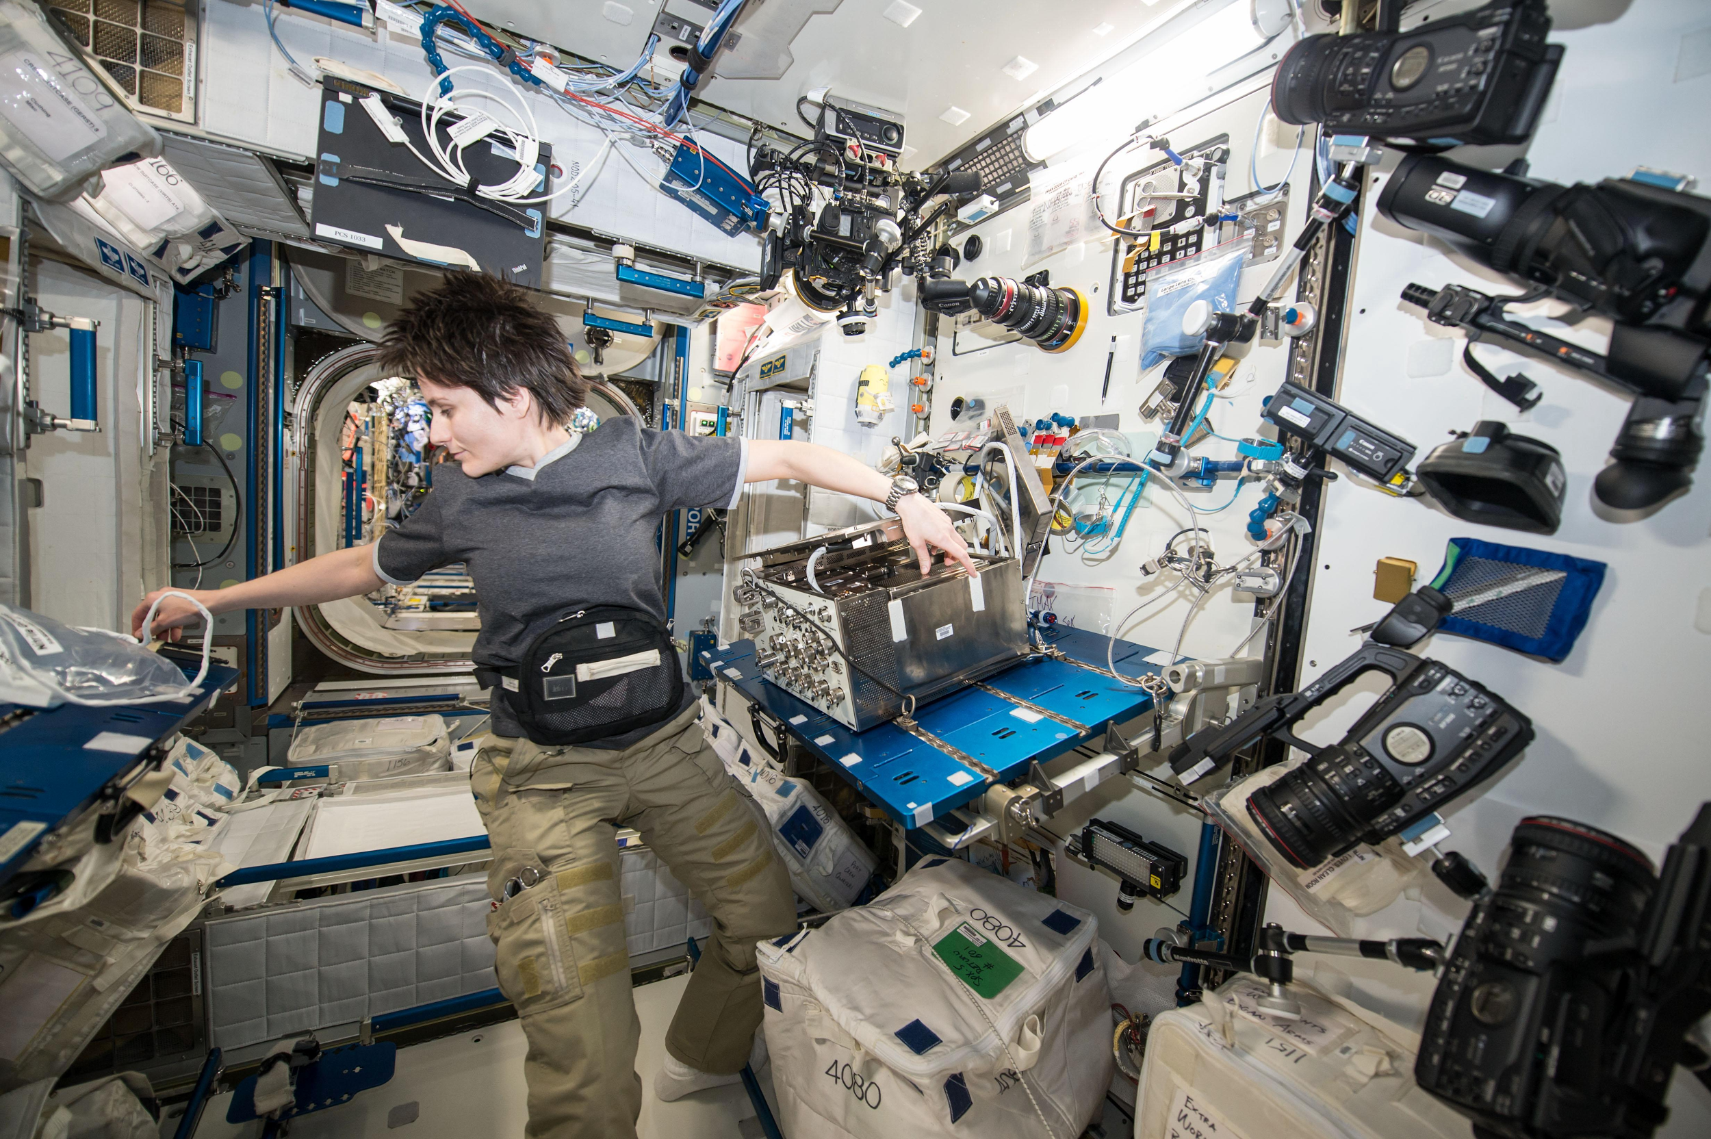
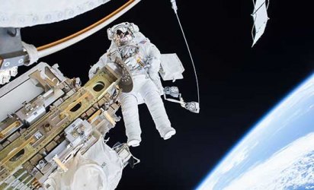
Physiological Effects of Plasma Radiation on Astronaut Health
NASA.gov
Notes:
Space has charged particles from our sun - Coronal Mass Ejecta (CME), Solar Proton Events (SPE) and Galactic Cosmic Rays (GCR). Humans living in space are constantly at risk for this radiation.

Slide 2
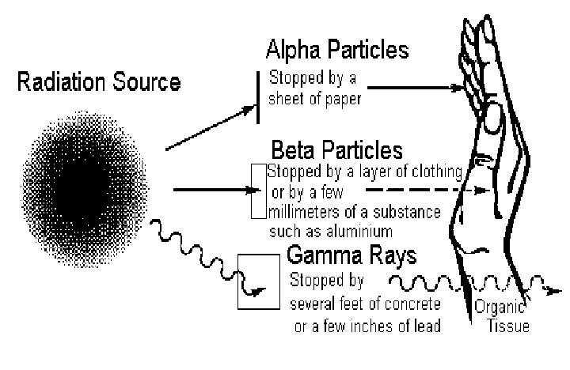
medi-wet.pl

Slide 3
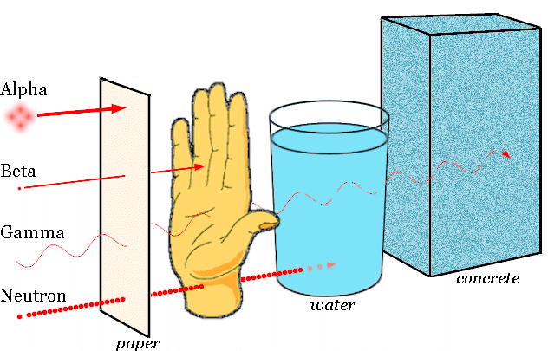
https://www.bcm.edu

Slide 4
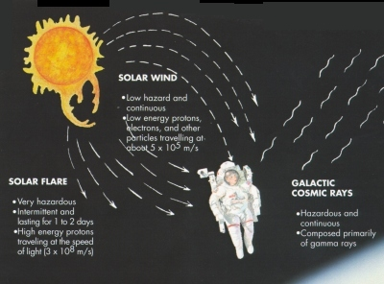
goflightmedicine.com

Slide 5
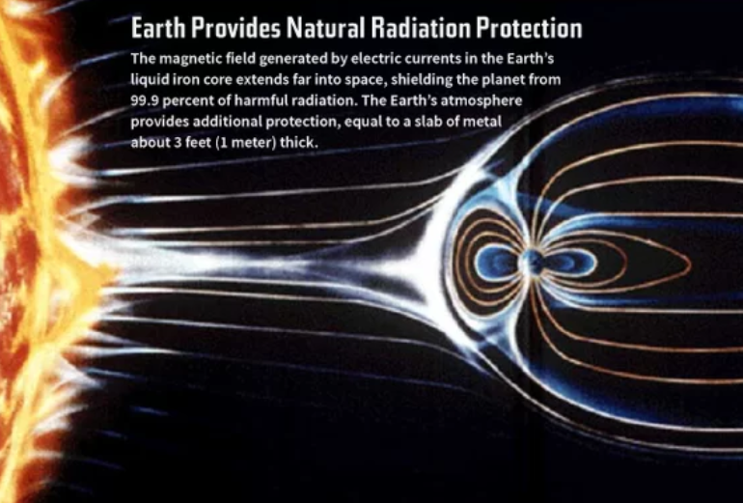
www.space.com

Slide 6
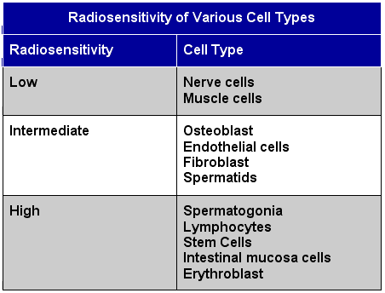
www.ceesentials.net
Notes:
Osteoblast – large cell in bone formation. Endothelial cells – line inside of blood vessel; Fibroblast - the most common cells of connective tissue in animals. Spermatids – immature sperm cells; Spermatogonia-undifferentiated male germ cell; lymphocytes- subtypes of white blood cell; erythroblast - A cell that contains hemoglobin and can carry oxygen to the body

Slide 7
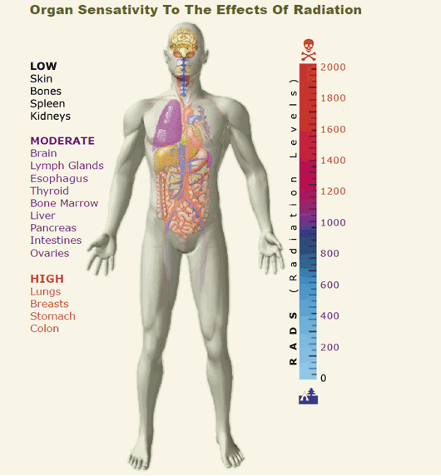
Allvitapoints.com

Slide 8
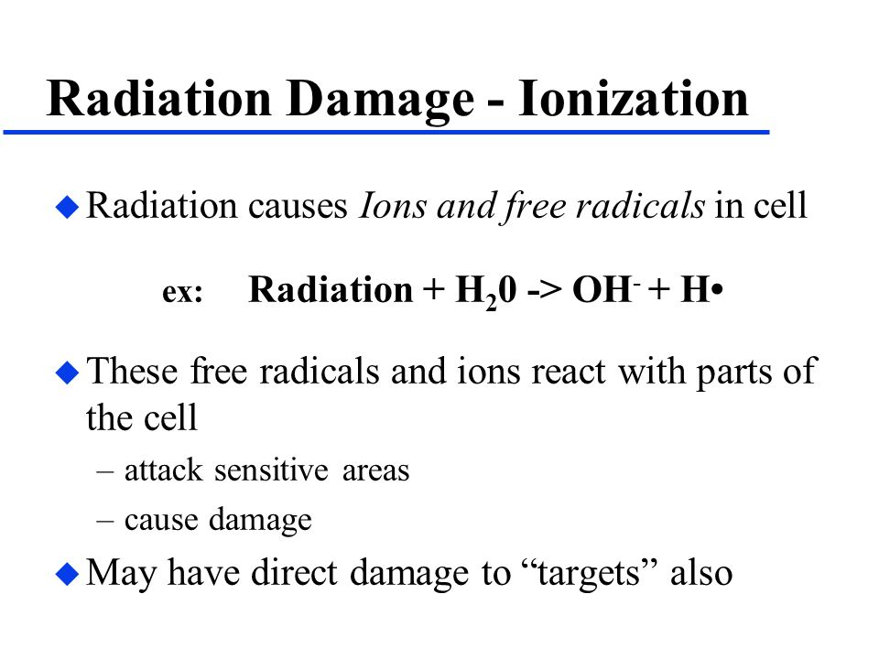

Slide 9
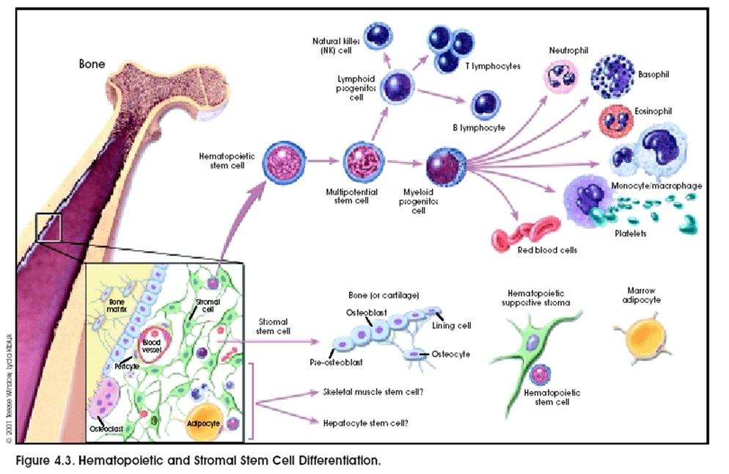
Medicalook.com

Slide 10
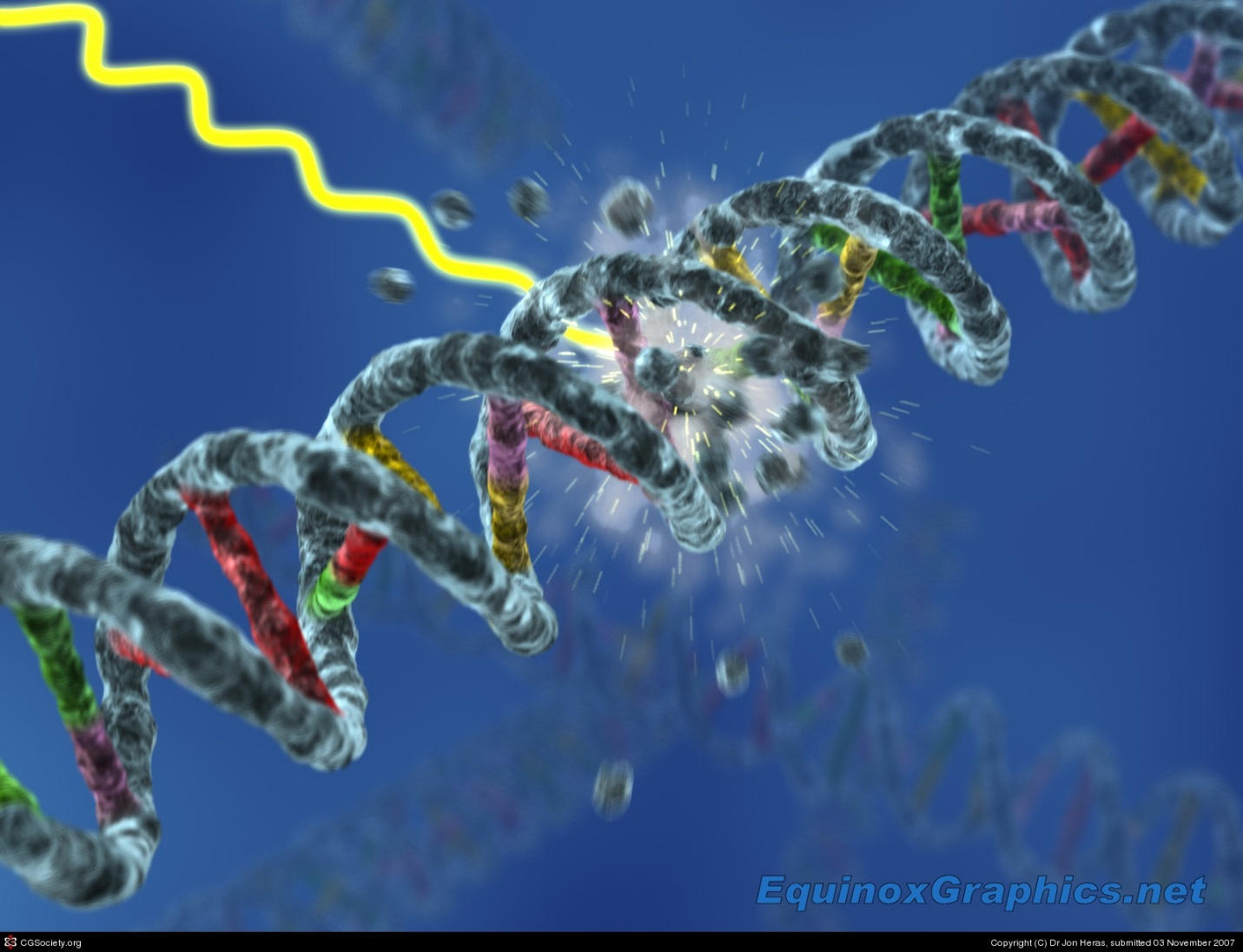

Slide 11
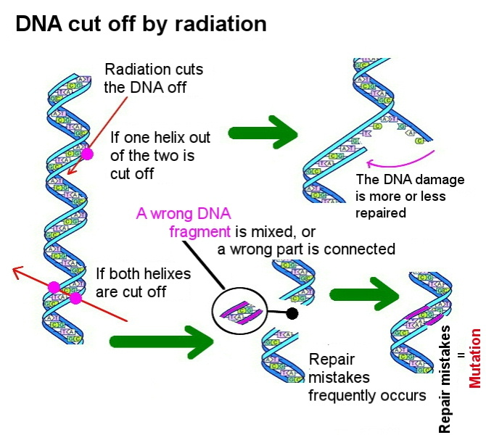
Nuketext.com

Slide 12
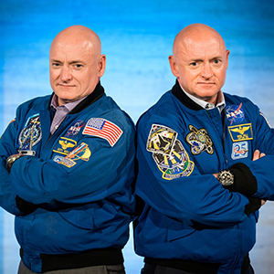
Scott Kelly received 24 x the radiation as Bro Mark.

Slide 13
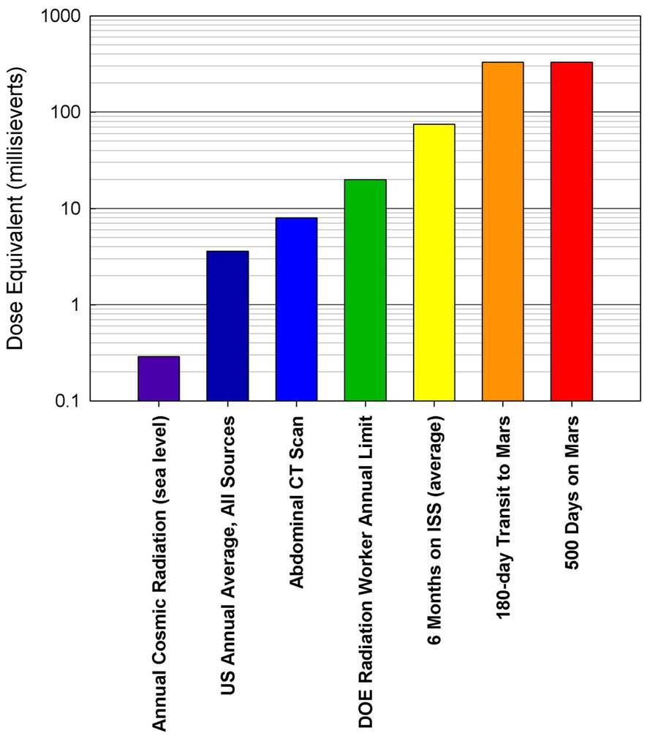
1millisievert=0.1 rad
Comparison of Radiation Doses – includes the amount detected on the trip from Earth to Mars
Kerr, Richard Kerr, Richard, May 31, 2013).
"Radiation Will Make Astronauts' Trip to Mars Even Riskier". Science. 340 (6136)
Notes:
A dose of 1 sievert is associated with a 5.5 percent increase in the risk of fatal cancers. The normal daily radiation dose received by the average person living on Earth is 10 microsieverts (0.00001 sievert).

Slide 14
Radiation |  | RBE
x-rays and -rays |  | 1
particles with energies larger than 0.03 MeV |  | 1
particles with energies less than 0.3 MeV |  | 1.7
thermal (slow-moving) neutrons |  | 3
fast-moving neutrons or protons |  | 10
-particles or heavy ions |  | 20
The Radiation Biological Effectiveness
RBE
of Various Forms of Radiation
Notes:
In radiobiology, the relative biological effectiveness (often abbreviated as RBE) is the ratio of biological effectiveness of one type of ionizing radiation relative to another, given the same amount of absorbed energy.
The higher the RBE or weighting factor for a type of radiation, the more damaging it is.

Slide 15
Allvitapoints.com
Notes:
The principal effect of low doses of ionizing radiation is to induce cancers, which may take up to 20 years to develop. High doses of ionizing radiation -Cells that are actively dividing are more sensitive to radiation than cells that aren't. Thus, cells in the liver, kidney, muscle, brain, and bone are more resistant to radiation than the cells of bone marrow, the reproductive organs, the epithelium of the intestine, and the skin, which suffer the most damage from radiation. Damage to the bone marrow is the main cause of death at moderately high levels of exposure (200 to 1000 rads). Damage to the gastrointestinal tract is the major cause of death for exposures on the order of 100 to 10,000 rads. Massive damage to the central nervous system is the cause of death from extremely high exposures (over 10,000 rads).

Slide 16

Mitigation
Use plastic-rich materials rather than Aluminum for construction of spacecraft
Use Liquid Hydrogen or Water for shielding
Use of Drugs
Timeliness of space travel
Notes:
Some of the drugs that are being considered are retinoids, which are vitamins with antioxidant properties, and molecules that retard cell division, giving the body time to fix damage before harmful mutations can be duplicated.
Timing of missions Due to the potential negative effects of astronaut exposure to cosmic rays, solar activity may play a role in future space travel. At NASA the space weather has been monitored since the days before the Apollo program[7]. Because galactic cosmic ray fluxes within the solar system are lower during periods of strong solar activity interplanetary travel during solar maximum should minimize the average dose to astronauts.

Slide 17
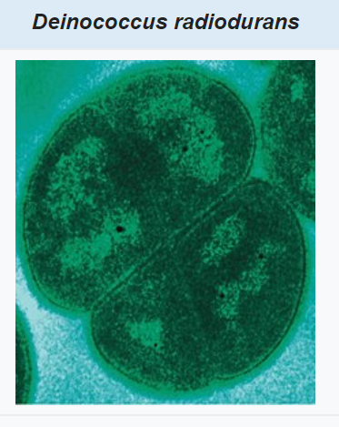
Conan the Bacterium-
It is extremely resistant to
Polyextremophile:
Resistant to ionizing radiation, ultraviolet light
Repairs single and double stranded damaged DNA.

Slide 18
Would YOU go to space?

Slide 19

Evaluation, please
Spacedge.academy

